Slide 1
Classes and methods

Slide 2
Methods
Python is also an object-oriented programming language, which has these defining characteristics: •
Programs include class and method definitions.
Most of the computation is expressed in terms of operations on objects.
Objects often represent things in the real world, and methods often correspond to the ways things in the real world interact.
a method is a function that is associated with a particular class.
Methods are semantically the same as functions, but there are two syntactic differences:
Methods are defined inside a class definition in order to make the relationship between the class and the method explicit.
The syntax for invoking a method is different from the syntax for calling a function.

Slide 3
class Time(object): time = Time()
time.hour = 11 time.minute = 59 time.second = 30 def print_time(time): print("%.2d:%.2d:%.2d" % (time.hour,
time.minute, time.second)) print_time(time)
• The syntax for a function call, print_time(time)
A method invocation is associated with class with dot operator
Time.print_time()
class Time(object): time = Time() time.hour = 11 time.minute = 59 time.second = 30 def print_time(time): print("%.2d:%.2d:%.2d" % (time.hour,
time.minute, time.second)) Time.print_time(time)
To make print_time() a method, move the function definition inside the class definition. Notice the change in indentation.

Slide 4
The initialization - init Method
The __init__ method is similar to constructors in C++ and Java.
It is run as soon as an object of a class is instantiated.
The method is useful to do any initialization for the object.
Its full name is __init__
two underscore characters, followed by init, and then two more underscores
It is common for the parameters of __init__ to have the same names as the attributes.
The statement self.hour = hour stores the value of the parameter hour as an attribute of self.
An init method for the Time class might look like this:
def __init__(self, hour=0, minute=0, second=0):
self.hour = hour
self.minute = minute
self.second = second

Slide 5
The __str__ Method
__str__ method, returns a string representation of an object.
For example, here is a str method for Time objects:
When an object is printed, Python invokes the str method
When a new class is written, always start by writing __init__, which makes it easier to instantiate objects, and __str__, which is useful for debugging
# inside class Time:
def __str__(self):
return '%.2d:%.2d:%.2d' % (self.hour, self.minute, self.second)
time = Time(9, 45)
print(time)

Slide 6
Operator Overloading
Operator overloading means giving extended meaning beyond their predefined operational meaning.
For example operator + is used to add two integers as well as join two strings and merge two lists.
It is possible because ‘+’ operator is overloaded by int class and str class.
To use + operator, the method __add__ is automatically invoked in which the operation for + operator is defined.
class complex:
def __init__(self, a, b):
self.a = a
self.b = b
# adding two objects
def __add__(self, other):
return self.a + other.a, self.b + other.b
Ob1 = complex(1, 2)
Ob2 = complex(2, 3)
Ob3 = Ob1 + Ob2
print(Ob3)

Slide 7
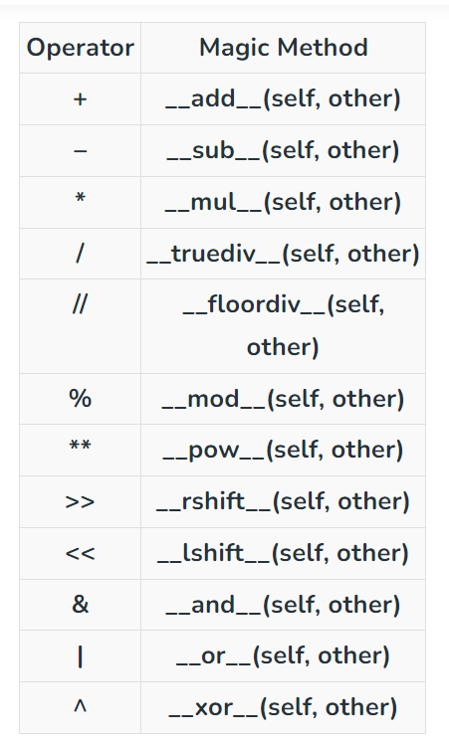
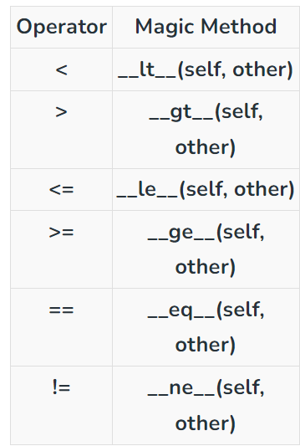

Slide 8
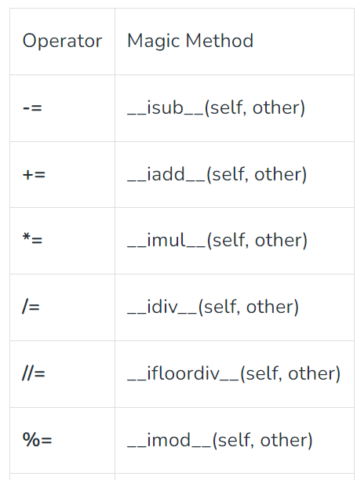
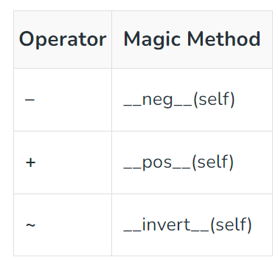
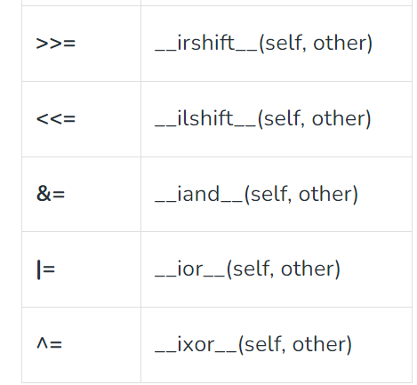

Slide 9
Type-Based Dispatch
class complex:
def __init__(self, a, b):
self.a = a
self.b = b
# adding two objects
def __add__(self, other):
return self.a + other.a, self.b + other.b
Ob1 = complex(1, 2)
Ob2 = complex(2, 3)
Ob3 = Ob1 + 23
print(Ob3)
type-based dispatch dispatches the computation to different methods based on the type of the arguments.
In the complex number addition example, two Complex number objects are added, an integer can also be added to a Complex number object
But this addition is not commutative
Ob3 = 23 + Ob2 will give an error
TypeError: unsupported operand type(s) for +: 'int' and 'instance'

Slide 10
A special method __radd__, which stands for “right-side add”.
This method is invoked when an object appears on the right side of the + operator.
Ob3 = 23 + Ob2
# inside class Time:
def __radd__(self, other):
return self.__add__(other)
print(23 + ob2)

Slide 11
Polymorphism
Reusing the single code multiple times.
Polymorphism means having many forms.
The same function name (but different signatures) being used for different types.
The key difference is the data types and number of arguments used in function.
Polymorphism can facilitate code reuse
def add(x, y, z = 0):
return x + y + z
print(add(2, 3))
print(add(2, 3, 4))

Slide 12
THANK YOU

